Slide 1
Dynamics of Communicable Diseases: Prevention and Control

Slide 2
Approach to Communicable Diseases
Lecture flow
Definition of terms
Importance of communicable diseases
Concepts used in communicable diseases:
The epidemiologic triad
The chain of infection.
Iceberg concept
Types of communicable diseases

Slide 3
Definition
A communicable disease (CD) is an illness that is transmitted from a person, animal or inanimate source to another person either by direct or indirect means
CD can present in an epidemic or endemic form.
Most communicable diseases are caused by microorganisms such as viruses, protozoa, bacteria and metazoa

Slide 4
Importance of Communicable Diseases:
Most of them are preventable
They are very common
Some may cause epidemics
Some may cause death or disability

Slide 5
Terminologies Used In Communicable Disease Epidemiology:
Epidemic/Epidemicity
Endemic/Endemicity
Pandemic/Pandemicity
Holoendemic/Holoendemicity
Hyperendemic/Hyperendemicity

Slide 6
Epidemic
The occurrence of disease or health related event in excess of normal expectancy.
Endemic
The constant presence of a disease or infectious organisms within a particular geographic area or population
Pandemic
An epidemic occurring across international boundaries and usually affecting many people

Slide 7
Holoendemic
State of a disease being very common in children and reaching a state of equilibrium such that adults are not as commonly affected as children e.g. malaria
Hyperendemic
A disease that is constantly present at a high incidence/prevalence and affects all age groups equally.

Slide 8
Explaining occurrence of disease: The Epidemiologic Triad
Syn: Epidemiologic Triangle
ET is the traditional epidemiologic model for explaining infectious disease causation. It has three components:
An External Agent
A Susceptible Host
The Environment

Slide 9
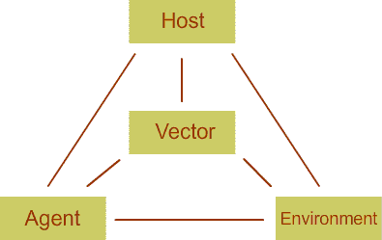
THE EPIDEMIOLOGIC TRIAD OF DISEASE CAUSATION

Slide 10
These three factors interact to cause disease: The agent needs a suitable environment in which to grow and multiply and thus be able to spread and infect a susceptible host living in the environment.

Slide 11
THE AGENT
Agent – can be micro-organisms (virus, bacteria, parasites etc) or chemical or physical factors.
The agent must be present for an infection to occur.

Slide 12
Characteristics of infectious disease agents
Six characteristics
They determine whether an agent:
Will cause disease
Will be transmitted to and infect a host.
Will cause death
Will evoke an immune response

Slide 13
Characteristics of an Infectious Disease Agent Cont’d
Infectivity – the ability of a disease agent to enter, survive and multiply in the host.
Pathogenicity- ability of an organism to cause disease
Virulence- the disease causing power (strength/fierceness) of a micro-organism in a host i.e. “the degree of pathogenicity”. The capacity of an infectious agent to cause death.

Slide 14
Immunogenicity is the ability of an infectious agent to produce an immune response which will protect the host form subsequent infection due to similar or related organism.

Slide 15
The Host/Reservoir
Host- A person or other living animal, including birds and arthropods, where an infectious agent lives and multiplies under natural conditions.
There are different types of hosts/reservoir:
Human reservoirs
Animal reservoir (cows, dogs, rats)
Arthropods
Reservoir-Any person, animal, arthropod, plant, soil, or substance, or combination of these in which an infectious agent normally lives and multiplies, and be transmitted to a susceptible host.

Slide 16
Categories of Hosts
Primary Host- where the parasite attains maturity or passes its sexual stage
Secondary/Intermediate Host; where the parasite is in a larval or asexual state are
A transport host is a carrier in which the organism remains alive but does not undergo development.

Slide 17
The Human Reservoirs
Two types of human reservoirs are recognised:
Symptomatic persons: these are sick people
Asymptomatic persons: these are carriers
A carrier is an infected person without symptoms but is capable of transmitting the agent to others.

Slide 18
Carrier state
A carrier state occurs when there is:
Presence of the disease agent in the body.
Absence of signs and symptoms of disease.
Continuous shedding of disease agent.

Slide 19
Carrier state cont’d
Carrier state occurs due to two main reasons:
Inadequate treatment or
Inadequate immune response,
The disease agent is thus not completely eliminated, leading to a carrier state.

Slide 20
Types of carriers
Asymptomatic carriers.
-Never show symptoms although infected
-Capable of transmitting the agent to others.
2. Incubatory & convalescent carriers.
-Persons capable of transmitting disease before and after they are clinically ill.
3. Chronic carriers.
-Persons who continue to habour an agent for a very long time following the initial infection (e.g. HBV, Salmonella Typhi)

Slide 21
Factors Contributing to the occurrence of Infectious Diseases
Host factors
Environmental factors
Agent factors
Microbial adaptation and change

Slide 22
Host factors that influence disease occurrence.
These are intrinsic factors that influence an individual’s exposure, susceptibility or response to a causative agent.
Examples of such host factors are:
Age/Gender/Race
Socio-economic status
Behaviours
Genetic constitution
Immunologic status

Slide 23
Environmental Factors
The extrinsic factors in which the disease-causing agent may exist, survive or originate. They include:
PHYSICAL FACTORS e.g. geology, climate, plants, and physical surroundings such as nursing homes, hospitals, factories
BIOLOGICAL FACTORS, such as vectors that transmit the agent
SOCIO-ECONOMIC FACTORS such as:

Slide 24
Overcrowding,
Sanitation
Poor housing
Technology and industry
Economic development and land use
International travel and commerce
Breakdown of public health measures

Slide 25
The Epidemiologic Beam Balance
A model depicting the balancing relationships of the agent, host and environmental.
When the balance of these three is constant there will be a fairly steady number of people getting sick.
If the agent has the upper hand a disease outbreak (epidemic) occurs

Slide 26
The Epidemiologic Beam Balance cont’d
ENDEMIC STATE
AGENT
HOST
ENVIRONMENT

Slide 27
Defeat/Disease/Epidemic
HOST
ENVIRONMENT
AGENT

Slide 28
Defence/Non-Disease
AGENT
ENVIRONMENT
HOST

Slide 29
The Iceberg Concept: clinical and Subclinical Disease
Diseases occur in a broad spectrum of severity. Epidemiology has called this theory - the iceberg concept.
This concept is used to describe the fact that only people with clinical manifestations of disease are seen, yet there are many in subclinical stages whose diseases are inapparent
i.e. those with hidden disease far from view are not seen only those with signs and symptoms are seen

Slide 30
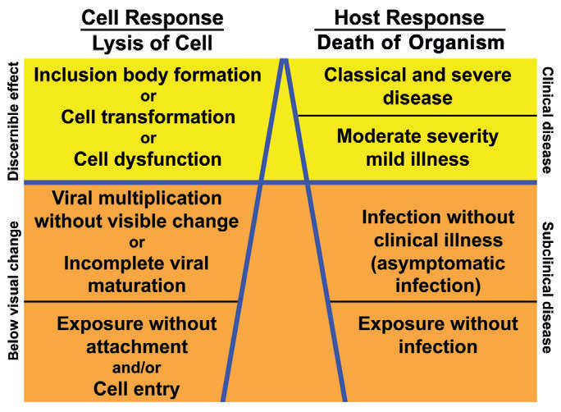
The Ice berg Concept

Slide 31
Natural History of Infectious Diseases
Natural history of disease refers to the progress of a disease in an individual over time in the absence of intervention.
The process begins with exposure to preclinical stage, to subclinical, clinical and ends with either recovery, disability or death.

Slide 32
Most diseases have a characteristic natural history although for some this is poorly understood.
Time frame and specific manifestations of disease may vary from individual to individual.
The usual course of a disease may be halted at any point in the progression by preventive and therapeutic measures, host factors and other influences.

Slide 33
Disease progresses naturally from exposure to outcomes:
Incubation period:
Time from exposure to development of disease.
Latent period:
The period between exposure and the onset of infectiousness (this may be shorter or longer than the incubation period).
A disease progresses from infection, incubation, S&S then end in either recovery, complications or death

Slide 34
CHAIN OF INFECTION (THE TRANSMISSION CYCLE)
Disease transmission occurs when the agent leaves its reservoir or host through a portal of exit and is conveyed by some mode of transmission and enters a susceptible host through an appropriate portal of entry. This progression is referred to as the chain of infection or the transmission cycle.

Slide 35
Portals of exit
Is the path by which an agent leaves the host e.g. respiratory passages, oral, nasal and anogenital orifices and skin.
The portal of exit usually corresponds to the site at which the agent is localised.

Slide 36
Portal of entry:
The portal of entry must provide access to tissues in which the agent can multiply or a toxin can act. Examples: respiratory system (influenza, cold), the mouth & digestive system (hepatitis A), mucous membranes or wounds in the skin.

Slide 37
Modes of Transmission :(Directly or Indirectly)
Direct Transmission:
Person to person by direct contact or by:
droplets
Sexual intercourse
Skin to skin contact
Blood transfusion
Direct blood contamination
Surgical procedures and
Needlestick accidents

Slide 38
Indirect Transmission:
Through an intermediary source such as:
Vehicles: H2O, infected blood, hypodermic needles, surgical instruments.
Fomites: inanimate objects : doorknobs, mobile phones or clothing.
Vectors: animate things : living insect or animal involved with transmission of the disease agent.

Slide 39
Vectors may carry the agent through mechanical or biologic transmission.
In MECHANICAL transmission the vector carry the agent on their appendages and the agent does not undergo a life cycle in the vector.
In other instances an agent undergoes part of its life cycle inside a vector before being transmitted to a new host, this type of transmission is BIOLOGIC.

Slide 40
Examples of transmission cycles:
Measles (D) MAN
droplets
MAN
Tetanus (ID) MAN
soil
MAN

Slide 41
Communicable Diseases Classification
1. Water-washed Diseases/Contageous Diseases
Scabies
Lice
Superficial Fungal Infections (Dermatophytosis)
Tropical Ulcers
Trachoma
Epidemic Haemorrhagic Conjunctivitis
Ophthalmia Neonatorum

Slide 42
COMMUNICABLE DISEASES CLASSIFICATION CONT’D
2. Faecal–Oral Diseases
Gastro-enteritis
Cryptosporidosis
Cholera
Bacillary Dysentery (Shigellosis)
Giardia
Amoebiasis
Typhoid
Hepatitis A (HAV)
Hepatitis E (HEV)
Poliomyelitis (Polio)
Enterobius (Pin Worm)

Slide 43
COMMUNICABLE DISEASES CLASSIFICATION CONT’D
3. Food-borne Diseases
Food Poisoning
Campylobacter Enteritis
The Intestinal Fluke (Fasciolopsis)
The Sheep Liver Fluke (Fasciola hepatica)
The Fish-transmitted Liver Flukes
The Lung Fluke
The Fish Tapeworm
The Beef and Pork Tapeworms
Trichinosis

Slide 44
COMMUNICABLE DISEASES CLASSIFICATION CONT’D
4. Diseases of Soil Contact
Trichuris (Whip Worm)
Ascaris
Hookworms
Strongyloides
Tetanus

Slide 45
COMMUNICABLE DISEASES CLASSIFICATION CONT’D
5. Airborne Transmitted Infections
Tuberculosis
Acute Respiratory Infections (ARI)
Influenza
Whooping Cough (Pertussis)
Diphtheria
Meningococcal Meningitis
Haemophilus influenzae (Meningitis and Pneumonia)
Pneumococcal Disease
Otitis Media
Acute Rheumatic Fever

Slide 46
Diseases Transmitted Via Body Fluids
Yaws
Pinta
Endemic Syphilis
Venereal Syphilis
Gonorrhoea
Non-gonococcal Urethritis (NGU)
Lymphogranuloma Venereum
Granuloma Inguinale
Chancroid
Genital Herpes
Human Papilloma Virus (HPV)
Human Immunodeficiency Virus (HIV)
Hepatitis (B, C, D)
Ebola Virus and Marburg Haemorrhagic Fever s
Lassa and Crimea–Congo Haemorrhagic Fevers

Slide 47
Insect/Vector-borne Diseases
Arboviruses
Japanese Encephalitis (JE)
Dengue
Yellow Fever
Malaria
Lymphatic Filariasis
Onchocerciasis
Loiasis
African Trypanosomiasis (Sleeping Sickness)
American Trypanosomiasis (Chagas’ Disease)
Leishmaniasis

Slide 48
Ectoparasite Zoonoses
Plague
Typhus
Louse-borne Relapsing Fever
Tick-borne Relapsing Fever
Diseases Transmitted by Hard Ticks
Tick Typhus/Fever
Rocky Mountain Spotted Fever
Lyme Disease
Arboviruses

Slide 49
Domestic and Synanthropic Zoonoses
Rabies
Hydatid Disease
Toxocariasis
Larva Migrans
Toxoplasmosis
Brucellosis
Anthrax
Leptospirosis
Lassa Fever

Slide 50
INFECTIOUS DISEASE CONTROL AND PREVENTION
Control can be directed at 5 levels
The agent,
The route of transmission,
The host
The environment.
Combined control strategies.

Slide 51
Controlling the Agent
Destruction of the agent either by:
Using drugs that kill the agent that live in the body,
Use of antiseptics, sterilization, incineration or radiation for agents which live outside the body.

Slide 52
Interrupting Transmission
Impede the movement of an agent from reservoir to the host.
Many methods of control have been developed to interrupt transmission because the agent is most vulnerable when travelling to the host.

Slide 53
Methods used to interrupt transmission:
Quarantine or isolation
Giving vaccination/prophylaxis to contacts
Improving environmental health
Destroying/vaccinating animal reservoir
Proper Cooking of food and
Boiling and proper water treatment
Vector control

Slide 54
Host protection
The host can be protected by:
Physical methods (mosquito nets, clothing, housing, repellants)
Vaccination against specific diseases or by taking regular prophylaxis.
Improvement of personal hygiene

Slide 55
Environment
The environment of the host can be improved by
Improvement of housing
Improvement of communications
Provision of safe water
Proper disposal of excreta and waste;
Others, such as meat inspection and hygiene.

Slide 56
The burden of communicable disease
Communicable diseases account for 14.2 million deaths each year.
Six diseases account for almost half of all premature deaths, mostly in children and young adults, and account for almost 80% of all deaths from infectious diseases:

Slide 57
Acute respiratory infections (3.76 million)
HIV/AIDS (2.8 million)
Diarrhoeal diseases (1.7 million)
Tuberculosis (1.6 million)
Malaria (1 million)
Measles (0.8 million)
Most of these deaths occur in low-income countries.

Slide 58
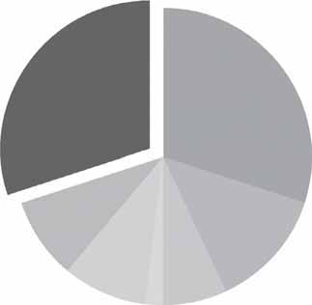
CD, MCH, Malnutrition, = 30%
CVDs 30%
Injuries 9%
Other chronic diseases 9%
Ca 13%
Chronic RSD 7%
DM 2%

Slide 59
Emerging and re-emerging Infectious Disease
Emerging disease is a disease that has never been recognized before: E.g., HIV/AIDS is an emerging disease, as is severe acute respiratory syndrome (SARS) and variant Creutzfeld-Jakob disease (vCJD)

Slide 60
Re-emerging diseases are those that have been around for decades or centuries, but have come back in a different form or a different location: E.g., West Nile virus in the Western hemisphere, monkeypox in the United States, and dengue rebounding in Brazil and other parts of South America

Slide 61
Emerging diseases
HIV, viral haemorrhagic fevers, Creutzfeld-Jakob disease and severe acute respiratory syndrome (SARS), diphtheria, yellow fever, anthrax, plague, dengue and influenza
These diseases place a large and unpredictable burden on health systems, particularly in low-income countries

Slide 62
Emerging Viral Diseases
HIV/AIDS
Viral haemorrhagic fevers include: Ebola, Marburg, Crimean-Congo, yellow fever, West Nile and dengue.
Poliomyelitis, the SARS coronavirus, influenza A (Bird Flu- H5N1) and the new variant Creutzfeldt–Jakob disease

Slide 63
Emerging bacterial diseases
Anthrax,
Cholera,
Typhoid,
Plague,
Borelliosis,
Brucellosis
Buruli ulcer
Leprosy

Slide 64
Emerging parasitic diseases
Malaria
Trypanosomiasis,
Leishmaniasis
Dracunculiasis

Slide 65
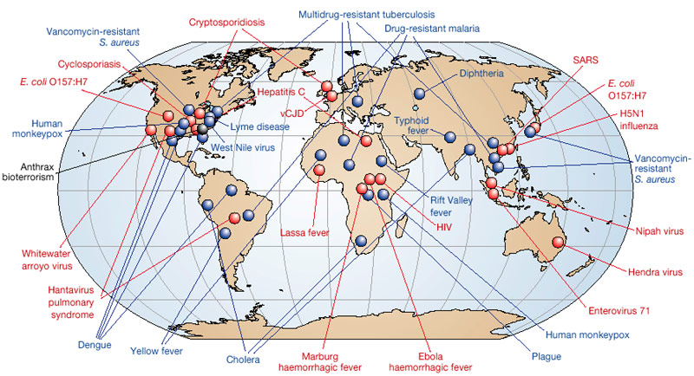
Emerging and re-emerging Infectious Disease -2006

Slide 66
Reasons for emerging diseases
Some may be genuinely new
Some may have been around but capacity to diagnose or detect them was lacking
Some occur due to new strains of viruses or bacteria
Changes in environmental and climatic conditions
Changes in host susceptibility
Others are deliberately introduced

Slide 67
International Health Regulations
The purpose of the IHRs is to maximize protection against the international spread of diseases. IHRs were adopted in 1969.
They were designed to control four infectious diseases: cholera, plague, yellow fever and smallpox. In 2005 IHRs were revised and developed to manage public health emergencies of international concern, regardless of the particular pathogen.

Slide 68
The new regulations oblige countries to:
Notify WHO of all “public health emergencies of international concern”;
Verify outbreaks at WHO’s request;
Maintain national core capacity for early warning and response; and
Cooperate with rapid international risk assessment and assistance.

Slide 69
Vaccination: A method of infectious disease control
The neonatal period and up to the first 6 months of age is protected by maternal antibodies
Thereafter babies acquire antibodies after a non lethal infection or following vaccination
Vaccination is the administration of altered antigenic material of the infective agent

Slide 70
Vaccination Vs immunization
The term vaccination is mostly used to indicate the administration of vaccine rather than immunization.
The term immunization is used to indicate the successful development of immunity following a vaccination.
Immunity does not follow a vaccination. This may be as a result of poor administration, impotent vaccine or the host may not mount an immune response. Therefore,

Slide 71
Types of vaccines
Four types vaccines which contain:
Live attenuated organisms e.g. measles, polio, BCG
Killed organisms, e.g. pertussis
Active components of organisms e.g. Hep B vaccine
Toxoids eg. Diptheria, Tetanus, Rabies

Slide 72
Vaccine transport and storage
Cold Chain- from factory to client
Freezer vaccines:
Polio
BCG
Measles
Fridge vaccines (4-8⁰C)
TT
DPT

Slide 73
Certain vaccines, such as measles and BCG, are sensitive to light.
Many potent vaccines are destroyed by being drawn up into syringes that are still warm from the sterilizing process.

